Slide 1
Generalized Out-of-Distribution Detection: A Survey
Submitted to IEEE TPAMI

Slide 2
Out-of-Distribution Detection
in-distribution (ID) ---- OOD
critical to ensuring the reliability and safety of machine learning systems
autonomous driving: we would like the driving system to issue an alert and hand over the control to humans when it detects unusual scenes or objects that it has never seen before and cannot make a safe decision.
Notes:
医学图像检测、自动驾驶、检测fake video/image

Slide 3
Generalized Out-of-Distribution
anomaly detection (AD)
novelty detection (ND)
open set recognition (OSR)
OOD detection
outlier detection (OD)

Slide 4



Preliminary
two general types of distribution shift:
covariate shift
semantic (label) shift
input (sensory) space
label (semantic) space
joint distribution P(X, Y )
Distribution shift can occur in either the marginal distribution P(X), P(Y ), or both.

Slide 5
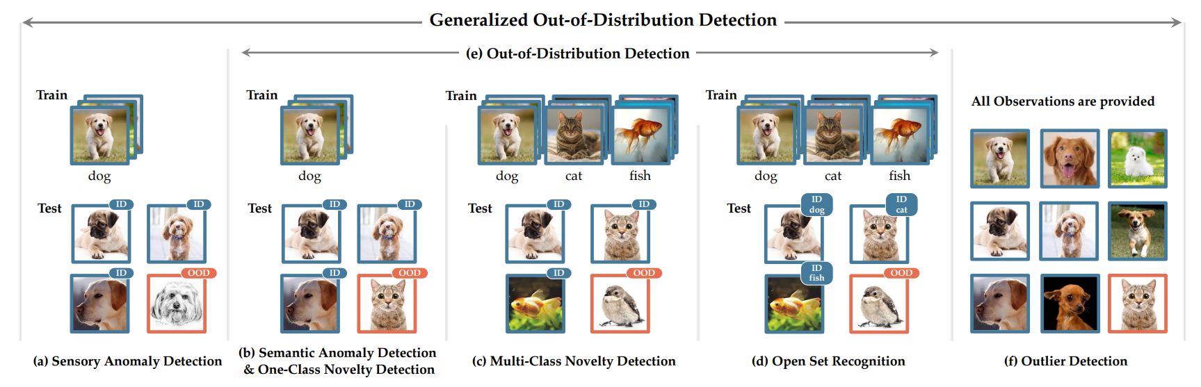
Notes:
AD: ID样本只在一类，或只有一种共同特性
AD ND：二分类 （只两类，ID or OOD）
OSR：多分类

Slide 6
Domain adaptation (DA) Domain Generalization (DG)
expects the existence of covariate shift during testing without any semantic shift, and requires classifiers to make accurate predictions regardless of the covariate shift

Slide 7
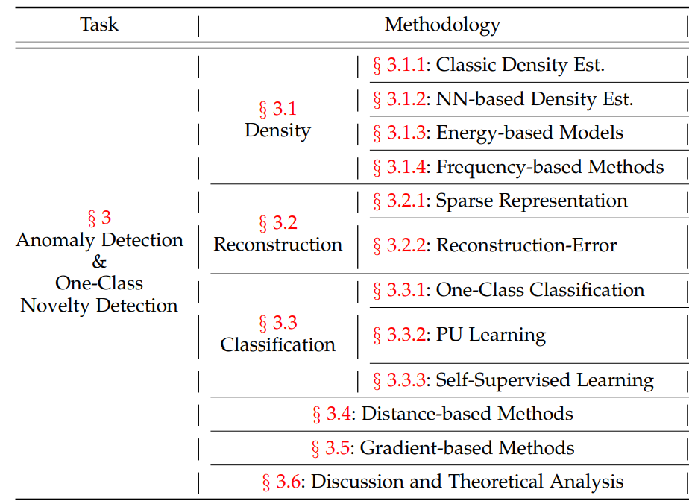
Notes:
estimate the in-distribution density and reject OOD test samples that deviate from the estimated distribute 例如Gaussian 分布
Generative If such a representation is not found, the sample is deemed anomalous
Frequency based 频域来选择，例如fake sample在频域的表现不同
Sparse Reconstruction指的 id可以用PCA、低秩等来表示 GAN based可以用discriminator来分辨
Ssl:两个方面 （1）feature更好的话，可以提高异常检测的performance （2）pretext task可以，例如contrastive learning，transformation prediction等anomalies are more likely to make mistakes on the designed task. For video data, a natural self-supervised task is to predict future frames based on the existing ones [146], where larger error indicates abnormalities
Distance –计算target sample和一系列exampler or prototypes的距离, novel sample与所有的距离远
Gradient-based：异常和正常的training gradient有区别

Slide 8
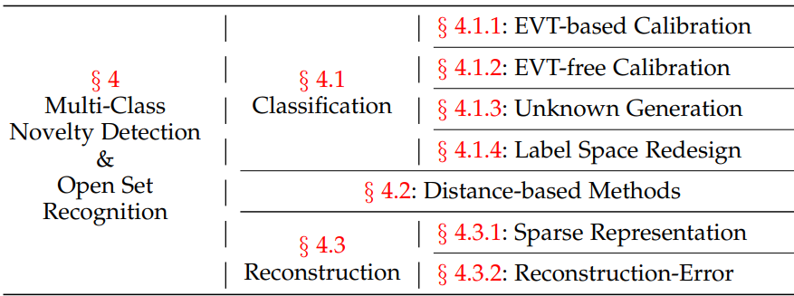
extreme value theory (EVT)
Notes:
ID data有多类
EVT：模型估计有极大极小值的长尾分布，估计样本属于极值的概率
EVT-free：用大量外部数据学习全局的负样本信息，让novel image的activation减弱。而known class的activation增强 用额外的transformation classification网络提取更强特征、计算input与latent feature的互信息
Unknown生成：1 合成unknown样本，来帮助识别。 2 另外，在training set中随机选择类别作为unknown进行训练，让网络有识别unknown类的能力 3训练数据划分为典型与不典型的子集，让网络划分界限更compact
Label redesign：dog-cat与dog-car应该是有不同的feature距离。用word embedding构建这种label space
Distance 聚类、prototypes，看sample与cluster等的距离
Reconstruction：latent feature 是Gaussian，接近于类别不同的Gaussian，这样可以识别不同的类，并reject unknown samples

Slide 9
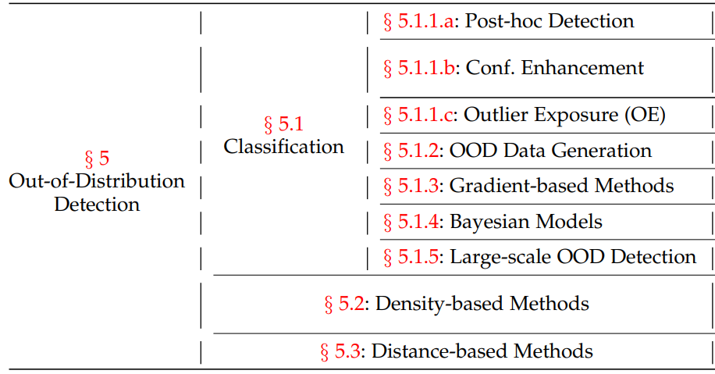
Notes:
Post-hoc：不改变model原本结构，做一些后处理 1. 熵：ood为均匀分布熵大 否则id 2. id与ood的bn统计量不同
Confidence enhancement：设计网络 eg。不确定度 2.提高对covariant shift的敏感，例如关注网络中间层
Outlier exposure：训练时给定一些ood sample进行训练，让网络 eg 1.学到在ood上高熵的prediction 2.压缩ood feature值域范围 3.另外predict一个ood类， 4为了更好的利用ood，还会进行ood数据的清理，防止里面有id数据
Data generation：用GAN合成ood数据进行训练
Bayesian Model：不确定度 偶然不确定度+认知不确定度 model uncertainty, data uncertainty, and distributional uncertainty e.g.测试的时候也用dropout，多次输入的不同值的variance作为uncertainty
Large scale： 大的数据集比较难做，semantic space太大。 1. 大的semantic space分为小的group，每个group有相似的concepts 2. pretrained transformer可以提高性能、
Density-based可以直接迁移过来。只是id数据每个类别预测

Slide 10
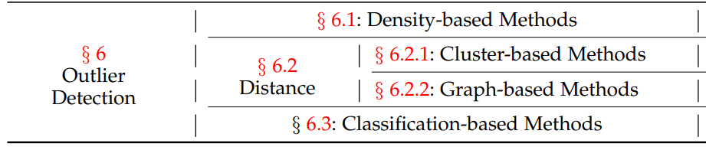
Notes:
Density 1. eg. 整个数据集用Gaussian分布，outlier sample至少在三个标准差之外
Cluster：在大多数cluster之外的被认为outlier
Graph：data point之间联系用graph建立寻找abnormal sample
Classification： 数据清理，可以对outlier sample有robust 增强model robustness和feature 泛化性的方法对OD有用，例如enseble、distillation、co training
OD 在做数据清理等比较有用

Slide 11
Challenges and Future Directions
Challenges
Proper Evaluation and Benchmarking
Outlier-free OOD Detection
Tradeoff Between Classification and OOD Detection
Real-world Benchmarks and Evaluations
Future Directions
Methodologies across Sub-tasks
OOD Detection & Generalization: An open-world classifier should consider two tasks, i.e., being robust to covariate shift while being aware of the semantic shift
OOD Detection & Open-Set Noisy Labels
Theoretical Analysis
Notes:
Benchmark的Ood中有id 以及不同的ood子任务有不同的评价标准
Ood很多方法需要额外的ood数据集
Tradeoff：比如让id cluster更compact
一般都在小数据上，例如cifar
Existing methods of learning from open-set noisy labels focus on suppressing the negative effects of noise. However, the open-set noisy samples can be useful for outlier exposure (c.f. 5.1.1) [308] and potentially benefit OOD detection.

Slide 12
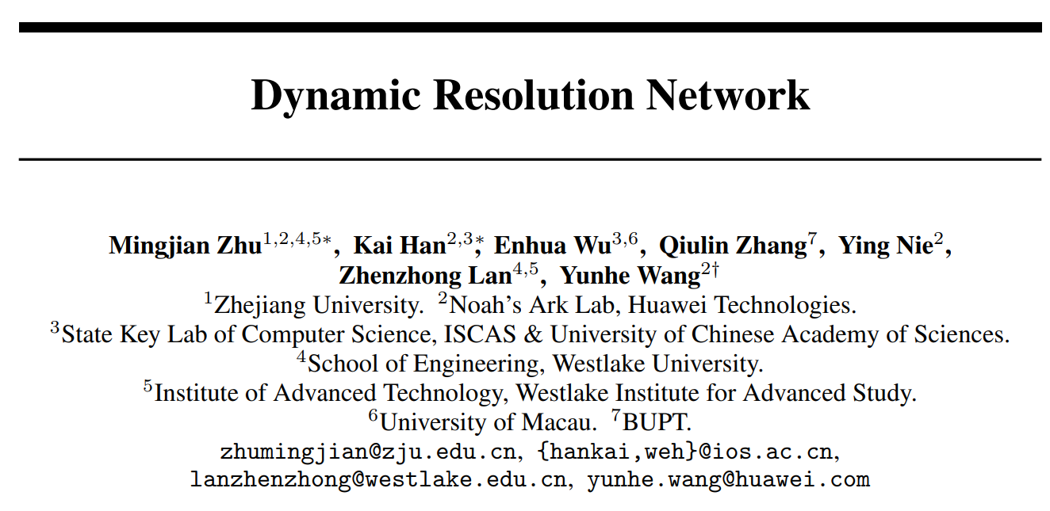

Slide 13
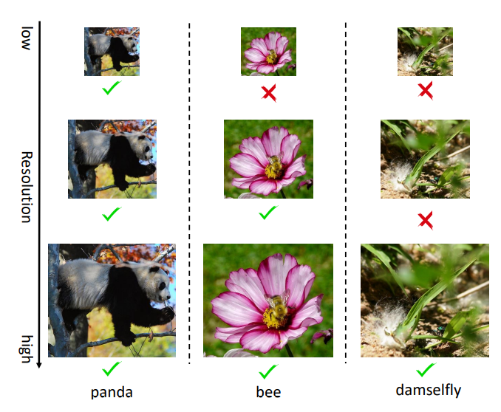
Motivation: the smallest resolution for accurately predicting the given image is different using the same neural network.
Notes:
小模型

Slide 14
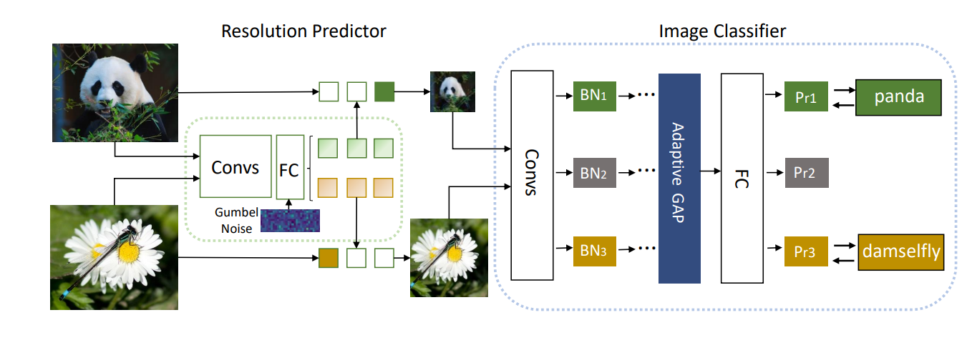

’Pri’: probability distribution over categories under resolution ri;
Gumbel-Softmax
Notes:
Resolution candidate提前设定

Slide 15




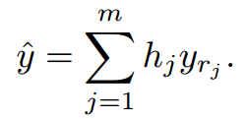
Optimization
1. Pretrained based network
2. train resolution predictor +finetune base network
a. resize image X into m candidate resolutions as Xr1; Xr2; · · · ; Xrm.
b. resolution predictor produce the resolution probability vector
for each image
c. transform into one-hot vector
d. obtain the final prediction of each resolution
e. sum them up with h
Notes:
If we use the Cross-Entropy loss only, the resolution predictor will converge to a sub-optimal point and tend to select the largest resolution because samples with the largest resolution correspond to relatively lower classification loss generall

Slide 16


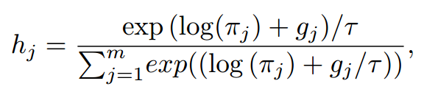
Gumbel-Softmax
continues outputs to discrete selection: non-differentiable problem
Notes:
gj is Gumbel noise obtained through two log operation applied on i.i.d samples u drawn from a uniform distribution
Gumbel noise has two positive effects ：
not influence the highest entry of the original categorical probability distribution
makes the gradient approximation from discrete hardmax to continuous softmax more fluent.
直接对模型预测的logits使用softmax得到的概率是确定的，而用gumbel_softmax得到的概率是基于logits的softmax结果采样得到的，是不确定的

Slide 17
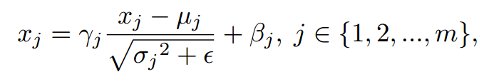
Problem
BN
activation statistics including means and variances under different resolutions are incompatible
Solution：resolution-aware BNs
Notes:
BN的统计量mean variance在不同resolution是不同的

Slide 18
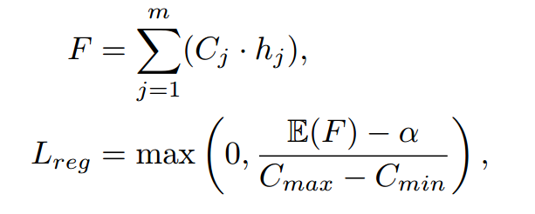
Loss
Cross entropy loss
FLOPs constraint loss
F is the actual inference FLOPs Cj is the pre-computed FLOPs value for the j-th resolution α is the target FLOPs.
Notes:
If we use the Cross-Entropy loss only, the resolution predictor will converge to a sub-optimal point and tend to select the largest resolution because samples with the largest resolution correspond to relatively lower classification loss generall

Slide 19
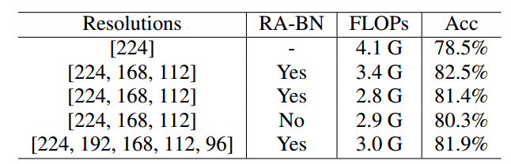
Experiments
Datasets: ImageNet
Resolution selection：

Slide 20
